Slide 1
THE EVOLUSION OF POLIS AND CIVILIZATION “Ancient Cities and their reflection to today’s world”
The first meeting of Grundtvig mobility in Greece.
COURSE: 2010-1-CY1-GRU06-009312
Athens and Lamia, from 22/10/2010 until 29/10/2010,
Lamia 2010 OCTOBER 24
Vangelis Markatselis director of Environmental education Center of Stylida –
Yiannis Bantekas drs Geology Un. Of Athens

Slide 2
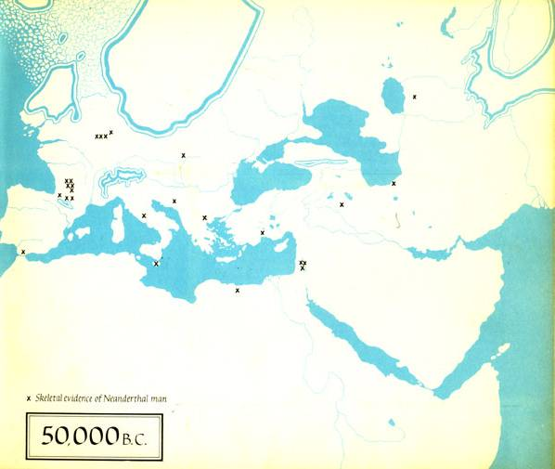

Slide 3
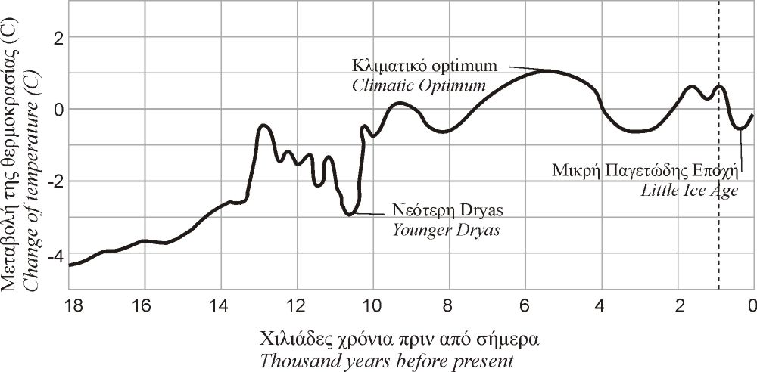
GLACIAL
WARM
MESOLITHIC
CHALCOLITHIC
PALAEOLITHIC
NEOLITHIC
BRONZE

Slide 4
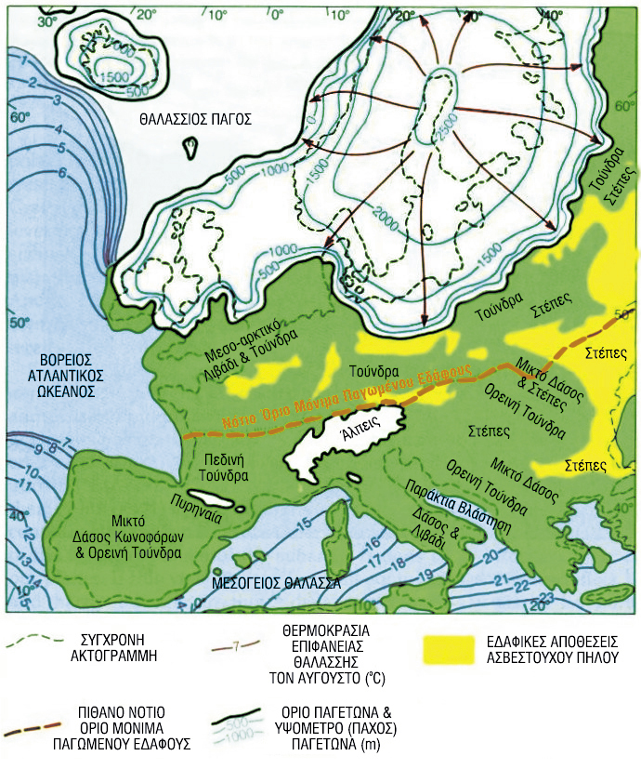
ΠΡΙΝ 18.ΟΟΟ ΧΡΟΝΙΑ 18.000 YARS AGO
Notes:
c. 18,000 BC—15,000 BC: Last Glacial Maximum. Mean Sea Levels are believed to be 110 to 120 meters (361 to 394 ft) lower than present,^{[7]} with the direct implication that many coastal and lower riverine valley archaeological sites of interest are today under water.
c. 18,000 BC: Spotted Horses, Pech Merle cave, Dordogne, France are painted. Discovered in December 1994.
c. 18,000 BC—11,000 BC: Ibex-headed spear thrower, from Le Mas d'Azil, Ariege, France, is made. It is now at Musee de la Prehistoire, Le Mas d'Azil.
c. 18,000 BC—12,000 BC: Mammoth-bone village in Mezhirich, Ukraine is inhabited.
c. 17,000 BC: Spotted human hands, Pech Merle cave, Dordogne, France are painted. Discovered in December 1994.
c. 17,000 BC—15,000 BC: Hall of Bulls, Lascaux caves, is painted. Discovered in 1940. Closed to the public in 1963.
c. 17,000 BC—15,000 BC: Bird-Headed man with bison and Rhinoceros, Lascaux caves, is painted.
c. 17,000 BC—15,000 BC: Lamp with ibex design, from La Mouthe cave, Dordogne, France, is made. It is now at Musee des Antiquites Nationales, St.-Germain-en-Laye.
c. 16,500 BC: Paintings in Cosquer cave, where the cave mouth is now under water at Cap Margiou, France were made.
c. 15,000 BC: Bison, Le Tuc d'Audoubert, Ariege, France.
[edit]16,000—12,000 BC
c. 15,000 BC-13,000 BC: Paleo-Indians move across North America, then southward through Central America.
c. 15,000 BC-12,000 BC: Pregnant woman and deer (?), from Laugerie-Basse, France was made. It is now at Musee des Antiquites Nationales, St.-Germain-en-Laye.
c. 14,000 BC: Paleo-Indians searched for big game near what is now the Hovenweep National Monument.
c. 14,000 BC: Bison, on the ceiling of a cave at Altamira, Spain, is painted. Discovered in 1879. Accepted as authentic in 1902.
c. 14,000 BC: Domestication of Reindeer.^{[8]}
13,000 BC: Beginning of the Holocene extinction event.
13,000 BC: earliest evidence of warfare
[edit]12,000—11,000 BC
11,500 BC—10,000 BC: Wooden buildings in South America (Chile), first pottery vessels (Japan).
11,000 BC: First evidence of human settlement in Argentina.
11,000 BC: The Arlington Springs Man dies on the island of Santa Rosa, off the coast of California.
11,000 BC: Human remains deposited in caves which are now located off the coast of Yucatán.^{[9]}
central and east Europe:30,000 BC, Szeletian culture
20,000 BC, Pavlovian, Aurignacian cultures
11,000 BC, Ahrensburg culture
10,000 BC, Epigravettian culture
9000 BC, Gravettian culture

Slide 5
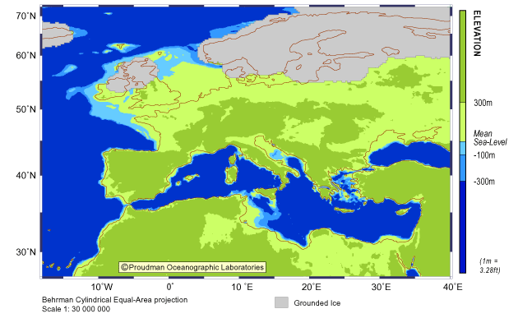
ΠΡΙΝ 18.000 ΕΤΗ - 18.000 YEARS AGO
Notes:
Large climate changes in Europe/Near East during the last 15,000 calendar years (note that these dates are in 'real' years not radiocarbon years).
14,500 y.a. - rapid warming and moistening of climates. Rapid deglaciation begins.
13,500 y.a. - climates about as warm and moist as today's
13,000 y.a. 'Older Dryas' cold phase (lasting about 200 years) before a partial return to warmer conditions.
12,800 y.a. (+/- 200 years)- rapid stepwise onset of the intensely cold Younger Dryas. Much drier than present over much of Europe and the Middle East, though wetter-than-present conditions at first prevailed in NW Europe.
11,500 y.a. (+/- 200 years) - Younger Dryas ends suddenly over a few decades, back to relative warmth and moist climates (Holocene, or Isotope Stage 1).
11,500 - 10,500 y.a. - climates possibly still slightly cooler than present-day.
9,000 y.a. - 8,200 y.a. - climates warmer and often moister than today's
about 8,200 y.a. - sudden cool phase lasting about 200 years, about half-way as severe as the Younger Dryas. Wetter-than-present conditions in NW Europe, but drier than present in eastern Turkey.
8,000-4,500 y.a. - climates generally slightly warmer and moister than today's.
(but; at 5,900 y.a. - a possible sudden and short-lived cold phase corresponding to the 'elm decline').
Since about 4,500 y.a. - climates fairly similar to the present
2,600 y.a. - relatively wet/cold event (of unknown duration) in many areas
(but; 1,400 y.a. {536-538 A.D.} wet cold event of reduced tree growth and famine across western Europe and possibly elsewhere).
(Followed by 'Little Ice Age' about 700-200 ya)

Slide 6
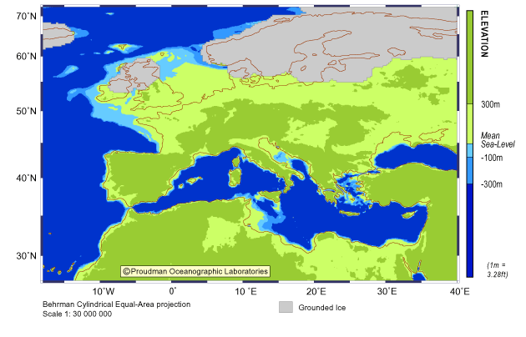
ΠΡΙΝ 17.000 ΕΤΗ 17.000 YEARS AGO

Slide 7
ΠΡΙΝ 16.000 ΕΤΗ - 16.000 YEARS AGO

Slide 8
ΠΡΙΝ 15.000 ΕΤΗ - 15.000 YEARS AGO
Notes:
The Upper Paleolithic (or Upper Palaeolithic, and also in some contexts Late Stone Age) is the third and last subdivision of the Paleolithic or Old Stone Age as it is understood in Europe, Africa and Asia. Very broadly it dates to between 40,000 and 10,000 years ago, roughly coinciding with the appearance of behavioral modernity and before the advent of agriculture. The terms "Late Stone Age" and "Upper Paleolithic" refer to the same periods. For historical reasons, "Stone Age" usually refers to the period in Africa, whereas "Upper Paleolithic" is generally used when referring to the period in Europe.

Slide 9
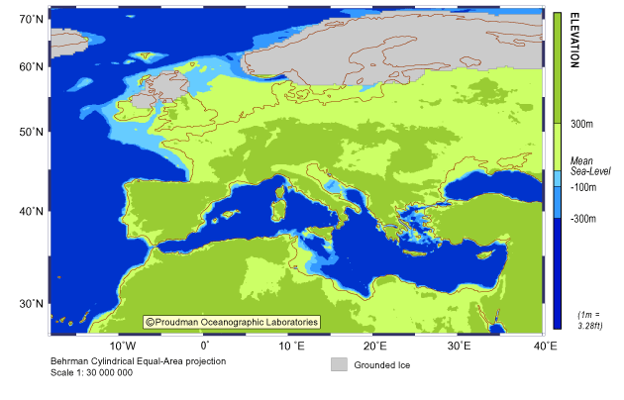
ΠΡΙΝ 14.000 ΕΤΗ -14.000 YEARS AGO

Slide 10
ΠΡΙΝ 13.000 ΕΤΗ - 13.000 YEARS AGO

Slide 11
ΠΡΙΝ 12.000 ΕΤΗ 12.000 YEARS AGO
Notes:
Europe: Permanent ecological change. The savannah-dwelling reindeer, bison, and Paleolithic hunters withdraw to the sub-Arctic, leaving the rest to forest animals likedeer, aurochs, and Mesolithic foragers. (1967 McEvedy)
World: Allerod oscillation brings transient improvement in climate. Sea levels rise abruptly and massive inland flooding occurs due to glacier melt.
Circa 9700 BC: Lake Agassiz forms.
Circa 9600 BC: Younger Dryas cold period ends. Pleistocene ends and Holocene begins. Paleolithic ends and Mesolithic begins. Large amounts of previously glaciated land become habitable again.

Slide 12
ΠΡΙΝ 11.000 ΕΤΗ 11.000 YEARS AGO
Notes:
c. 9000 BC: Temporary global chilling, as the Gulf Stream pulls southward, and Europe ices over (1990 Rand McNally Atlas)
c. 8000 BC—World—Rising Sea

Slide 13
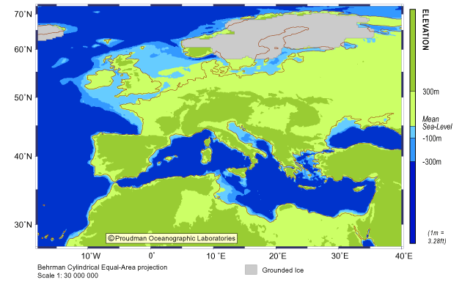
ΠΡΙΝ 10.000 ΕΤΗ 10.000 YEARS AGO
Notes:
Large outflow of fresh water from Black Sea Agian Sea

Slide 14
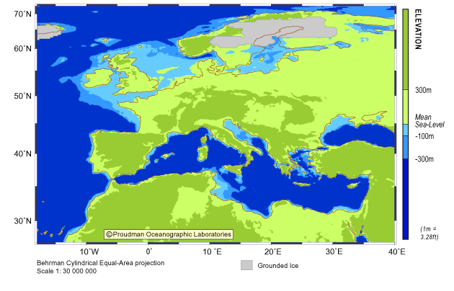
ΠΡΙΝ 9.000 ΕΤΗ - 9.000 YEARS AGO
Notes:
c. 7000 BC: Beginning the Holocene climatic optimum.
c. 6000 BC: The land bridge connecting England with the rest of Europe disappears beneath the waters of the North Sea and the English Channel.
c. 5600 BC: According to the Black Sea deluge theory, the Black Sea floods with salt water. Some 3000 cubic miles (12,500 km³) of salt water is added, significantly expanding it and transforming it from a fresh-water landlocked lake into a salt water sea.

Slide 15
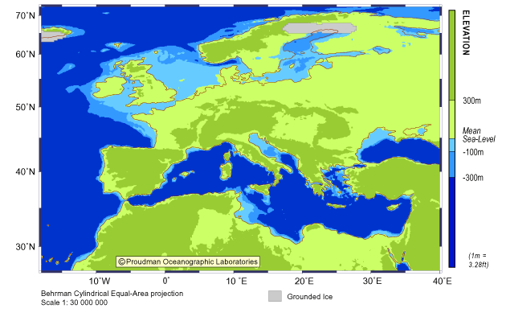
ΠΡΙΝ 8.000 ΕΤΗ - 8.000 YEARS AGO
Notes:
6000 BC: Rising sea levels form the Torres Strait, separating Australia from New Guinea
c. 6000 BC: Between 12,000 BC and 5,000 BC it appears that massive inland flooding was taking place in several regions of the world, making for subsequent sea level rises which could be relatively abrupt for many worldwide.

Slide 16
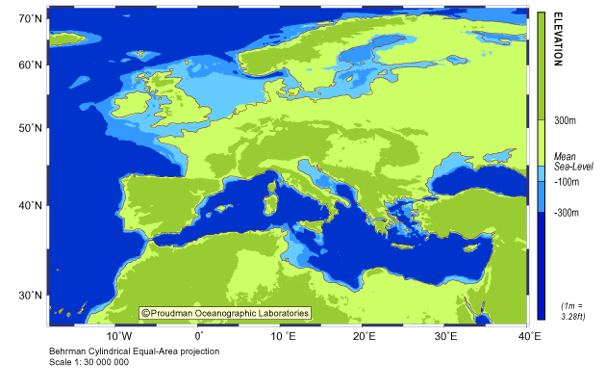
ΠΡΙΝ 7.000 ΕΤΗ - 7.000 YEARS AGO

Slide 17
ΠΡΙΝ 6.000 ΕΤΗ - 6.000 YEARS AGO

Slide 18
ΠΡΙΝ 5.000 ΕΤΗ - 5.000 YEARS AGO

Slide 19
THE END OF PRΕHISTORY

Slide 20
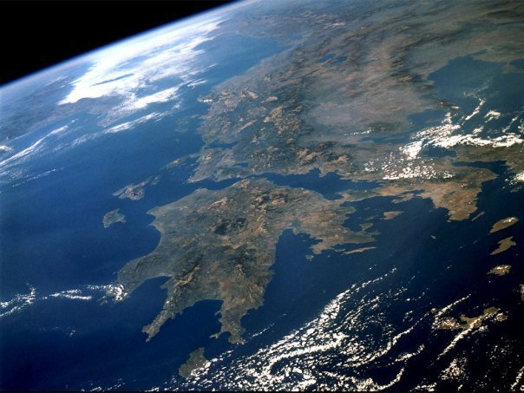
NEOLITHIC DIMINI 7500 BP

Slide 21
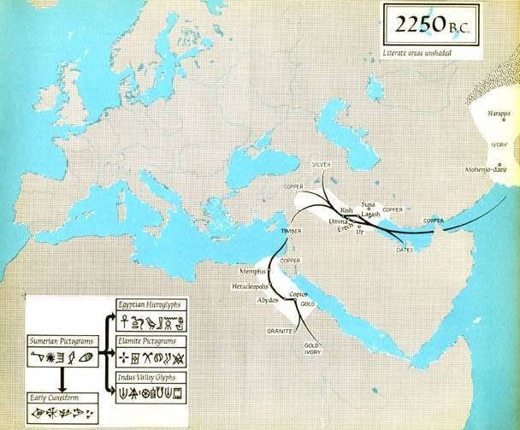
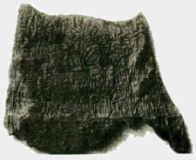
4.250 YEARS AGO
ΠΡΙΝ 4.250 ΕΤΗ
THE ORIGINS OF WRITING
IS THE END OF THE PEHISTORY
INDUS VALEY
GLYPHS
SILVER
DISPILIO C¹⁴ ⁼ 5260 BCE
GOPPER
GOPPER
EGYPTIAN
IEROGLYPHS
GOPPER
SUMERIAN
PICTOGRAMMS
GOPPER
GOLD
ELAMITE
PICTOGRAMMS
GRANITE
GOLD
IVORY

Slide 22
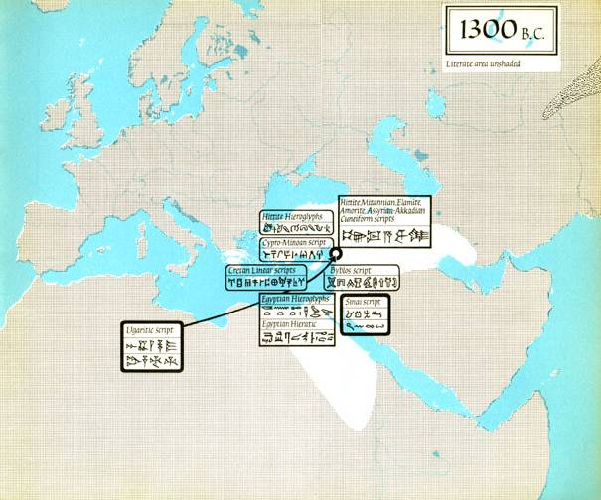
3.300 YEARS AGO
ΠΡΙΝ 3.300 ΕΤΗ
GREEK-MINOAN LINEAR SCRIPTS
HETTITE ELAMITE
ASSYRIAN SCRIPTS
BYTHOS SCRIPTS
UGARIT
SCRIPT
EGYPTIAN

Slide 23
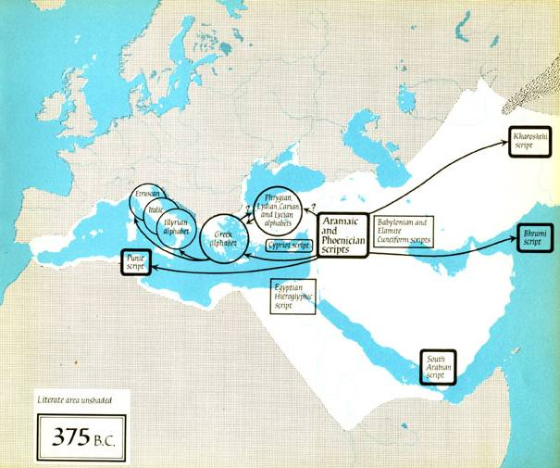
2.375 YEARS AGO
ΠΡΙΝ 2.375 ΕΤΗ

Slide 24
CITIES

Slide 25
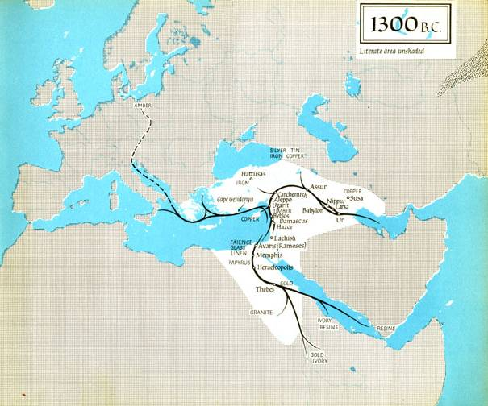
3.300 YEARS AGO
ΠΡΙΝ 3.300 ΕΤΗ
AMBER
TIN
THE JASON AND THE ARGONAUTS
GOLD-IRON-SILVER
TIN - COPPER
TIN - COPPER
TIN
IRON
COPPER
COPPER
GLASS
LINEN
PAPYRUS
GRANITE
IVORY
GOLD
RESINS
TIN 10% + COPPER 90% = BRONZE

Slide 26
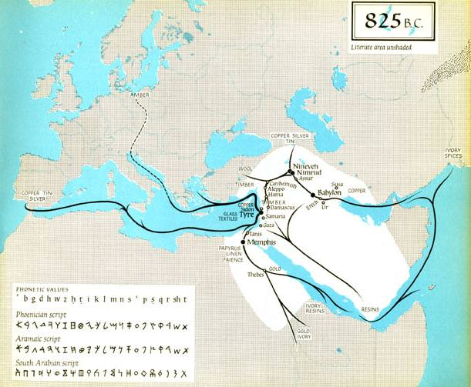
2.825 YEARS AGO
ΠΡΙΝ 2.825 ΕΤΗ
ANCIENT CITIES
NINEVEH
NIMRUD
BABYLON
MEMPHIS
TYRE

Slide 27
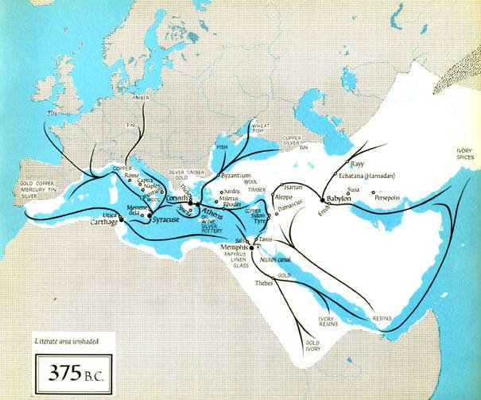
2.375 YEARS AGO
ΠΡΙΝ 2.375 ΕΤΗ

Slide 28
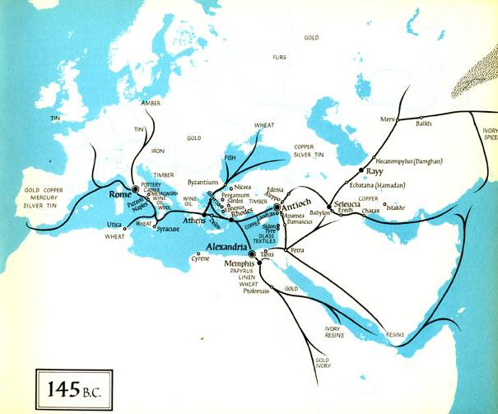
2.145 YEARS AGO
ΠΡΙΝ 2.145 ΕΤΗ

Slide 29
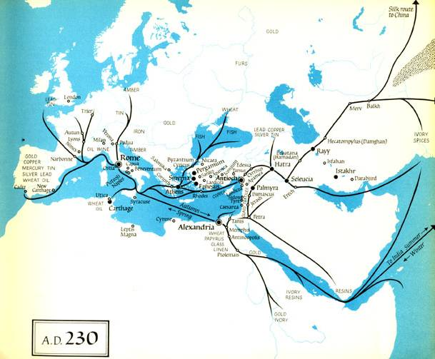

Slide 30
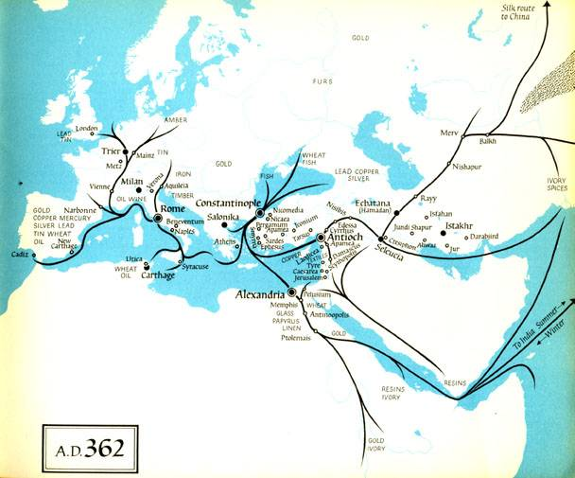

Slide 31
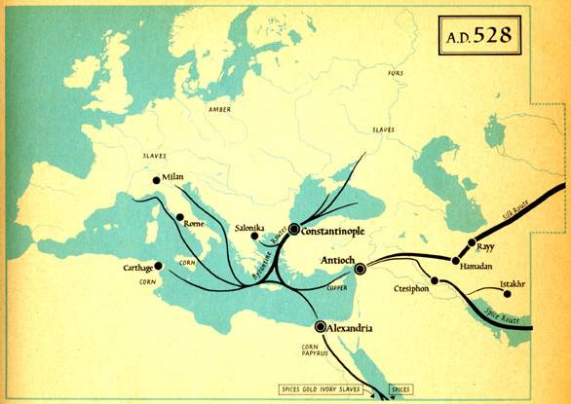

Slide 32
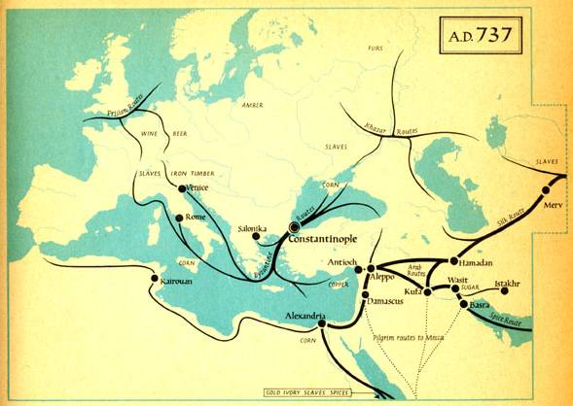

Slide 33
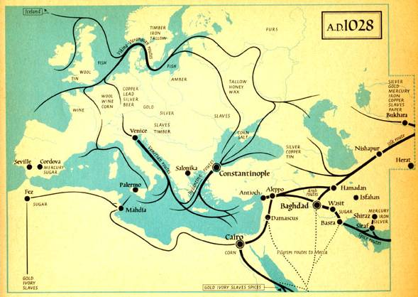

Slide 34
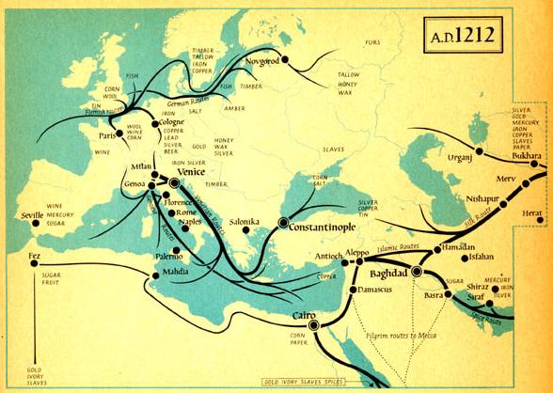

Slide 35
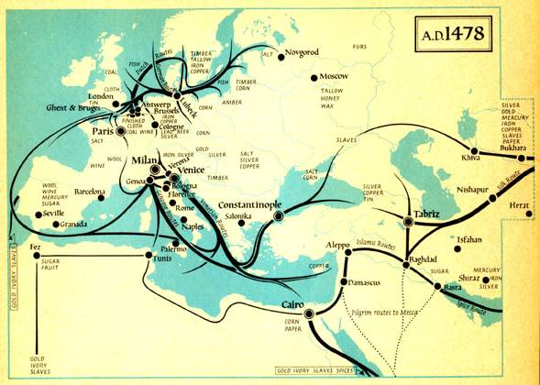

Slide 36
2.480 YEARS AGO ΠΡΙΝ 2.480 ΕΤΗ ΜΑΧΗ ΘΕΡΜΟΠΥΠΩΝ THE BATLE OF THEROPILAE

Slide 37
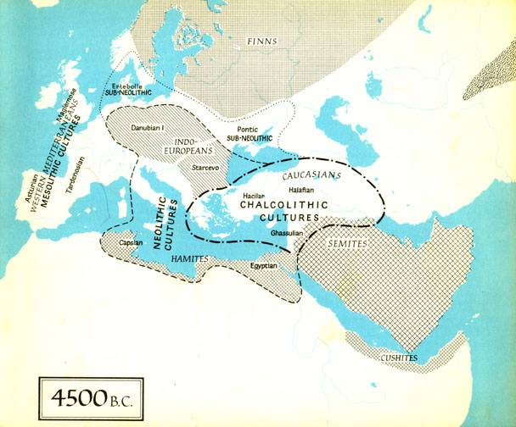
SUB-NEOLITHIC
SUB-NEOLITHIC LIMIT
SUB-NEOLITHIC LIMIT
MESOLITHIC
NEOLITHIC LIMIT
NEOLITHIC
LIMIT OF COPPER CHALCOLITHIC
MESOLITHIC
NEOLITHIC LIMIT
CHALCOLITHIC
6.500 YEARS AGO
ΠΡΙΝ 6.500 ΕΤΗ

Slide 38
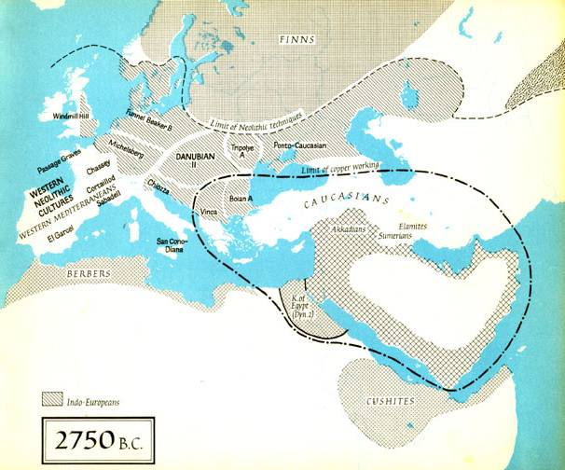
NEOLITHIC
NEOLITHIC
NEOLITHIC
NEOLITHIC LIMIT
LIMIT OF COPPER CHALCOLITHIC
COPPER
COPPER
LIMIT OF COPPER CHALCOLITHIC
4.750 YEARS AGO
ΠΡΙΝ 4.750 ΕΤΗ

Slide 39
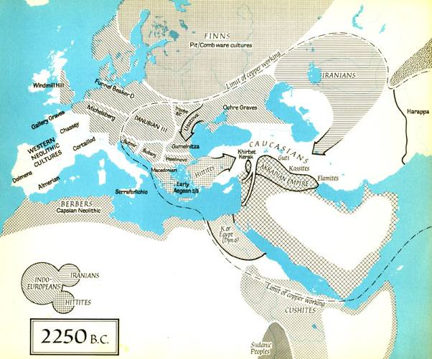
NEOLITHIC
NEOLITHIC
LIMIT OF COPPER CHALCOLITHIC
NEOLITHIC
NEOLITHIC
CHALCOLITHIC
COPPER
NEOLITHIC
LIMIT OF COPPER CHALCOLITHIC
4.250 YEARS AGO
ΠΡΙΝ 4.250 ΕΤΗ

Slide 40
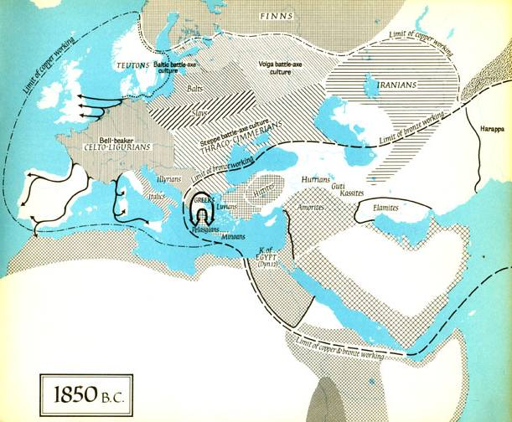
TIN
COPPER
COPPER
TIN
COPPER
BRONZE
3.850 YEARS AGO
ΠΡΙΝ 3.850 ΕΤΗ

Slide 41
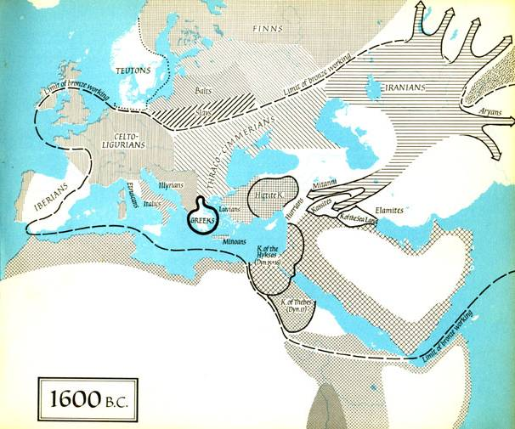
TIN
COPPER
BRONZE
TIN
COPPER
3.600 YEARS AGO
ΠΡΙΝ 3.600 ΕΤΗ

Slide 42
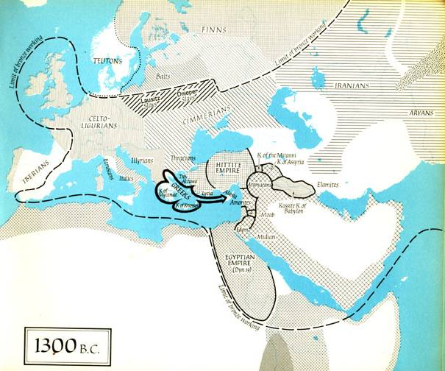
TIN
BRONZE
TIN –
COPPER
3.300 YEARS AGO
ΠΡΙΝ 3.300 ΕΤΗ

Slide 43
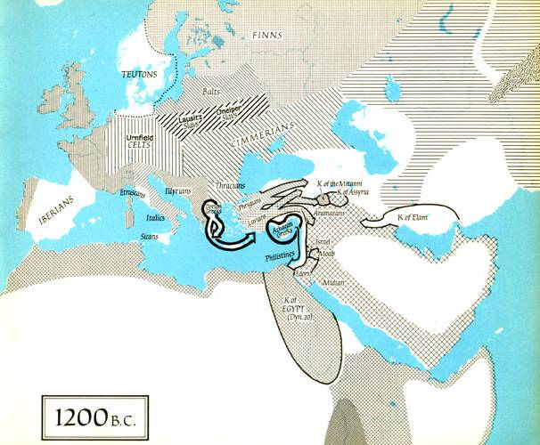
3.200 YEARS AGO
ΠΡΙΝ 3.200 ΕΤΗ
THE TROJAN WAR

Slide 44
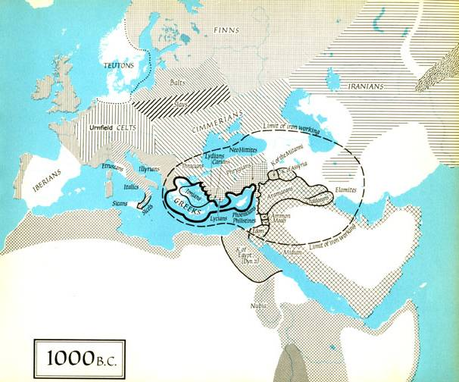
ΙRΟΝ
3.000 YEARS AGO
ΠΡΙΝ 3.000 ΕΤΗ

Slide 45
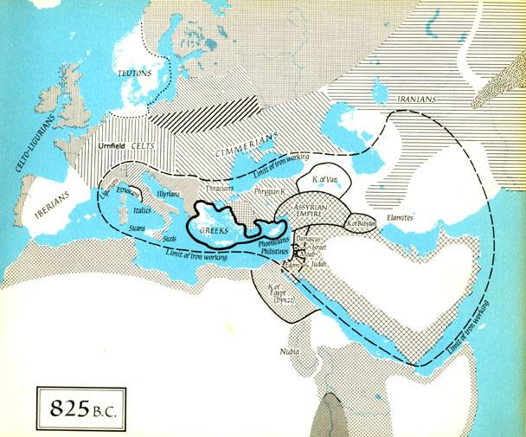
ΙRΟΝ
2.825 YEARS AGO
ΠΡΙΝ 2.825 ΕΤΗ

Slide 46
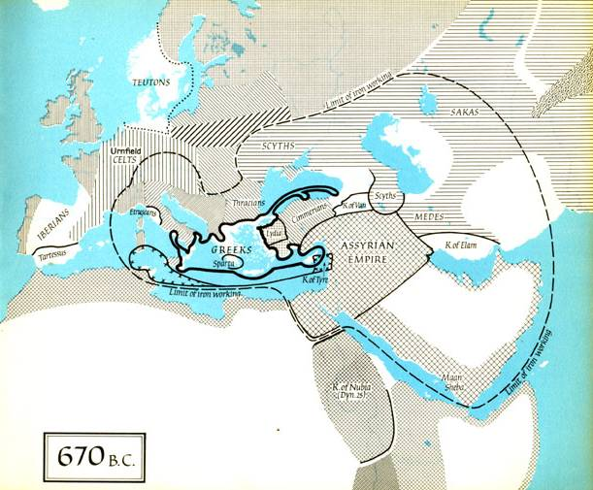
ΙRΟΝ
2.670 YEARS AGO
ΠΡΙΝ 2.670 ΕΤΗ

Slide 47
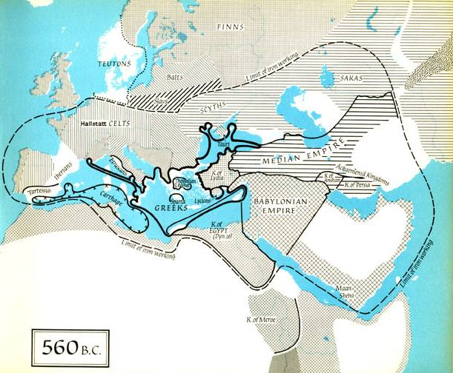
ΙRΟΝ
2.560 YEARS AGO
ΠΡΙΝ 2.560 ΕΤΗ

Slide 48
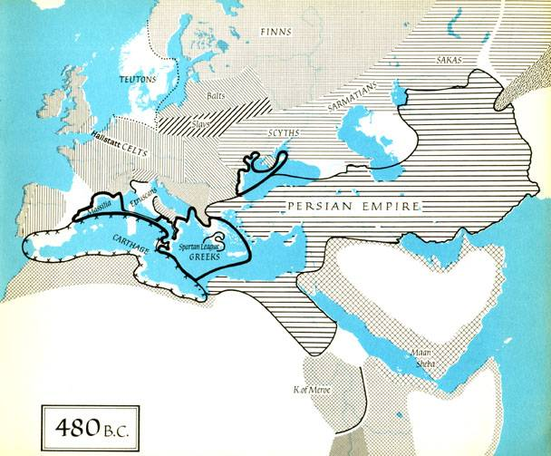
2.480 YEARS AGO
ΠΡΙΝ 2.480 ΕΤΗ
ΜΑΧΗ ΘΕΡΜΟΠΥΠΩΝ
THE BATLE OF THEROPILAE

Slide 49
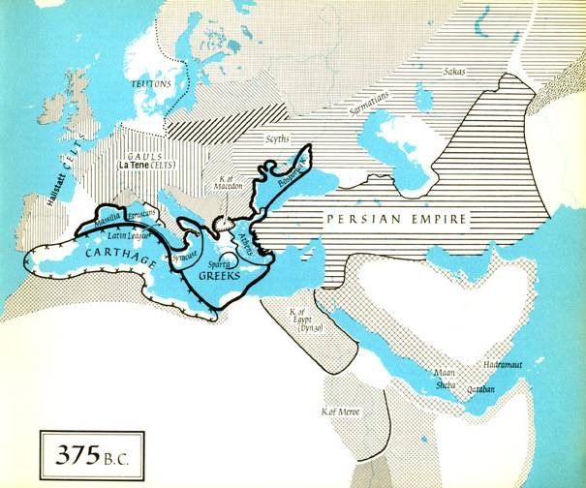
2.375 YEARS AGO
ΠΡΙΝ 2.375 ΕΤΗ

Slide 50
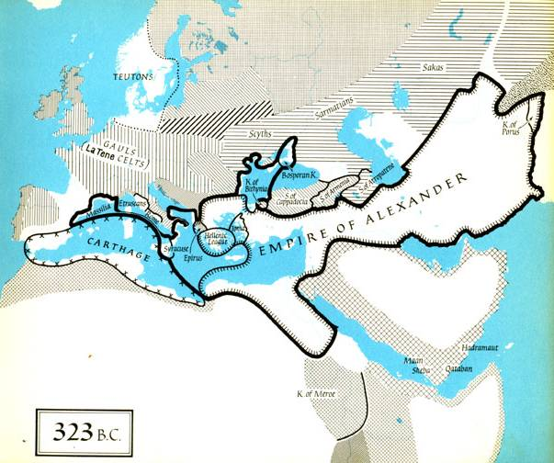
2.323 YEARS AGO
ΠΡΙΝ 2.323 ΕΤΗ

Slide 51
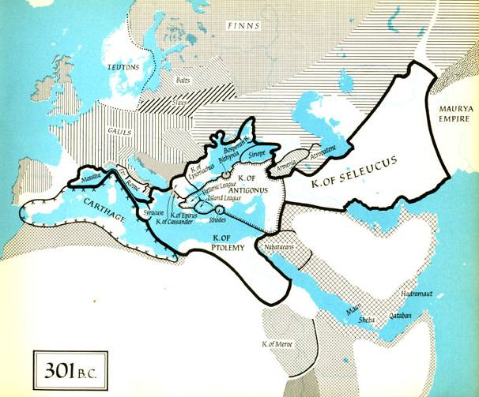
2.300 YEARS AGO
ΠΡΙΝ 2.300 ΕΤΗ

Slide 52
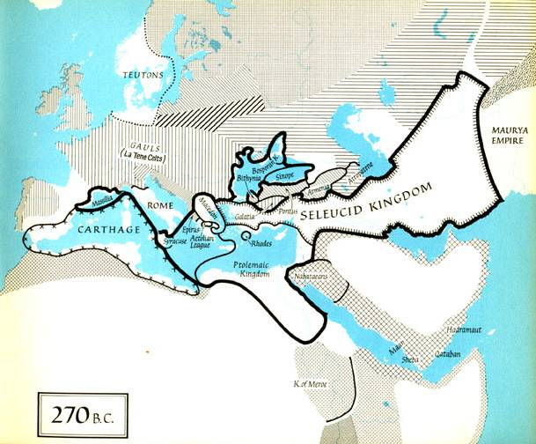
2.270 YEARS AGO
ΠΡΙΝ 2.270 ΕΤΗ

Slide 53
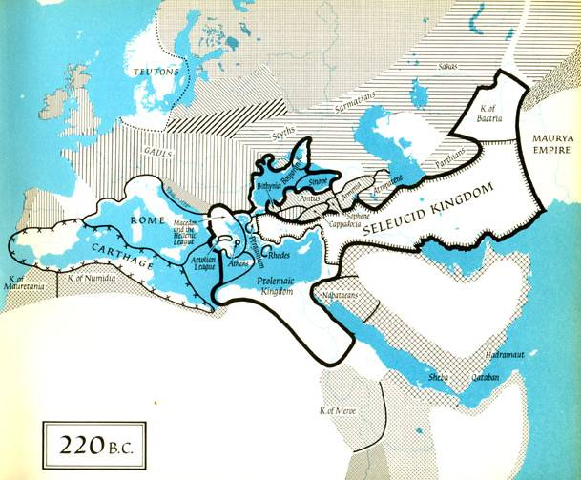
2.220 YEARS AGO
ΠΡΙΝ 2.220 ΕΤΗ

Slide 54
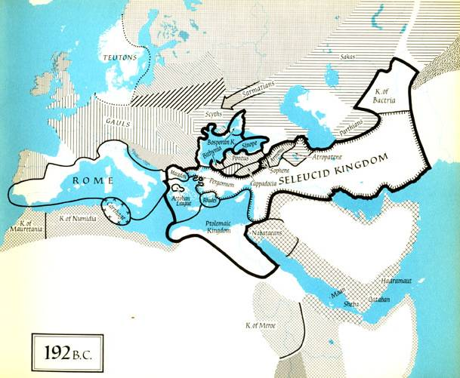
2.192 YEARS AGO
ΠΡΙΝ 2.192 ΕΤΗ

Slide 55
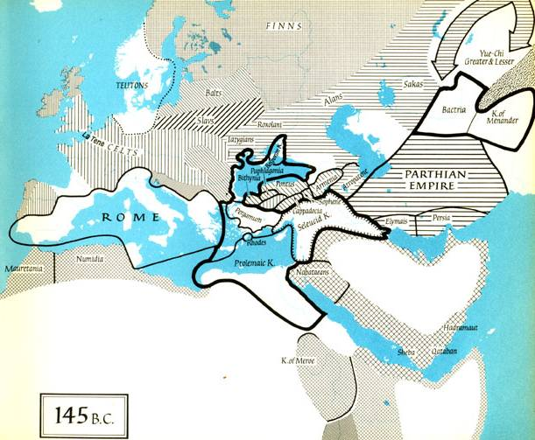
2.145 YEARS AGO
ΠΡΙΝ 2.145 ΕΤΗ

Slide 56
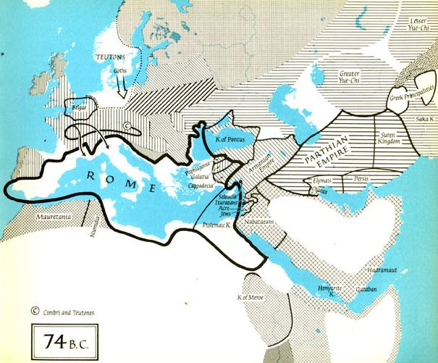
2.074 YEARS AGO
ΠΡΙΝ 2.074 ΕΤΗ

Slide 57
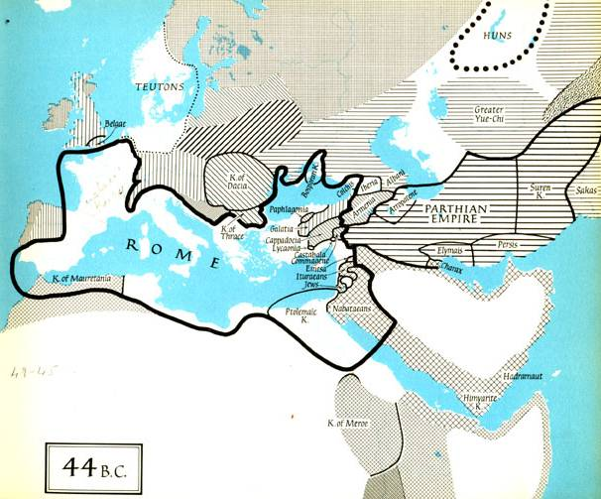
2.044 YEARS AGO
ΠΡΙΝ 2.044 ΕΤΗ

Slide 58
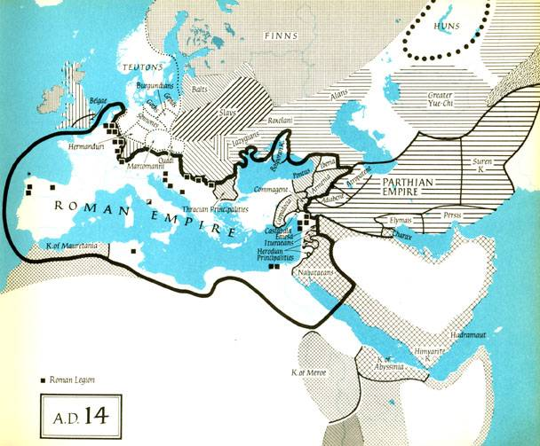
2.014 YEARS AGO
ΠΡΙΝ 2.014 ΕΤΗ

Slide 59
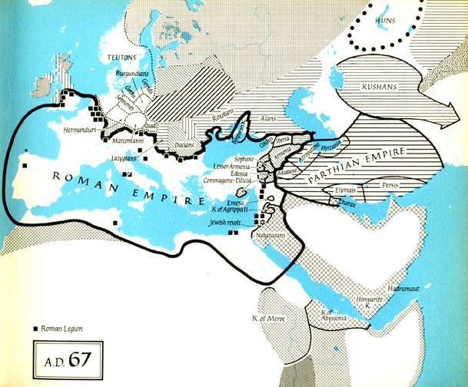

Slide 60
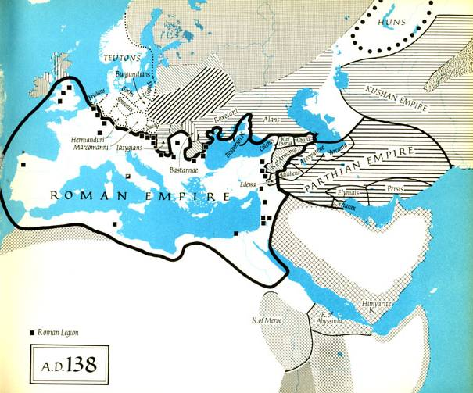

Slide 92
RELIGION
ONLY WESTERN AND EAST CRISTIANITY

